Slide 1
LECTURE FIVE
Introducing Classes

Slide 2
AN EXAMPLE OF OBJECT ORIENTED PROGRAMMING
Colored points on the screen
What data goes into making one?
  Coordinates
  Color
What should a point be able to do?
  Move itself
  Report its position

Slide 3
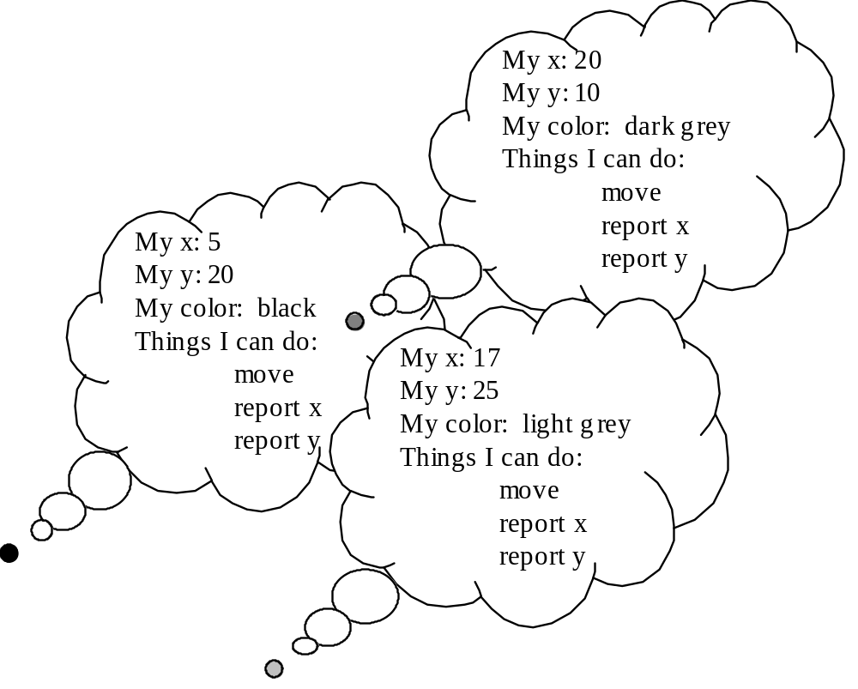

Slide 4
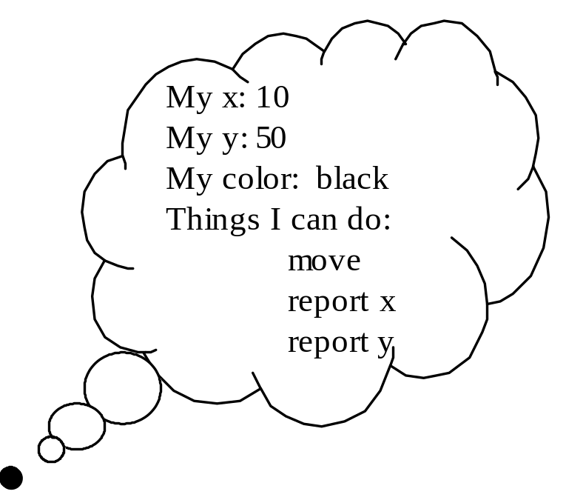
JAVA TERMINOLOGY
Each point is an object
Each includes three fields
Each has three methods
Each is an instance of the same class

Slide 5
OBJECT-ORIENTED STYLE
Solve problems using objects: little bundles of data that know how to do things to themselves
Not the computer knows how to move the point, but rather the point knows how to move itself
Object-oriented languages make this way of thinking and programming easier

Slide 6
class Point {
int xCoord;
int yCoord;
Point() {
xCoord = 0;
yCoord = 0;
}
int currentX() {
return xCoord;
}
int currentY() {
return yCoord;
}
void move (int newXCoord, int newYCoord) {
xCoord = newXCoord;
yCoord = newYCoord;
}
}

Slide 7
THE GENERAL FORM OF A CLASS
A class is defined by specifying the data and the code that operate on the data.
The general form:
class classname{
type instance-variable1;
type instance-variable2;
…………
type methodname1( parameter-list)
{
// body of the method
}
type methodname2( parameter-list)
{
//body of the method
}
……………………
}

Slide 8
CLASS AND OBJECT
A class defines a new data type. This new data type is used to create objects of that type.
A class is a template for an object and an object is an instance of a class.

Slide 9
A SIMPLE EXAMPLE
class Box
{
double width;
double height;
double depth;
}
class BoxDemo
{
public static void main( String args[])
{
Box mybox, mybox1;
mybox = new Box();
mybox1 = new Box();
mybox.width=10;
mybox.height = 20;
mybox. depth = 15;
mybox1.width = 10;
mybox1.height = 25;
mybox1.depth=5;
}
}

Slide 10
CREATING OBJECTS
Obtaining objects of a class is two steps process:
1. Declare a variable of the class type.
2. Acquire an actual, physical copy of the object and assign it to that variable.
To allocate a physical memory new() is used. It dynamically allocates memory for an object and returns a reference to it.
In Java, all class objects must be dynamically allocated.
General form:
class-var = new classname();

Slide 11
A CLOSER LOOK AT NEW
Box mybox;
mybox = new Box();
Box b1 = new Box();
Box b2 = b1;
null
mybox
Width
Height
mybox
Call to the default constructor defined by the compiler. It initializes the instance variables to 0.
Depth
b1
Width
b2
Height
Depth

Slide 12
REFERENCES
An reference variable holds the memory address.
It is similar to the pointer.
Key difference- cannot manipulate as pointer– It cannot point any arbitrary memory location or it cannot be manipulate like an integer.

Slide 13
THE NULL REFERENCE
An object reference variable that does not currently point to an object is called a null reference
The reserved word null can be used to explicitly set a null reference:
name = null;
An object reference variable declared at the class level (an instance variable) is automatically initialized to null
The programmer must carefully ensure that an object reference variable refers to a valid object before it is used

Slide 14
INTRODUCING METHODS
The general form of a method:
type name (parameter list)
{
// body of the method
}
Type can be any valid type including class types that you create.
A method is always invoked with respect to an object. So, inside a method the object is known and there is no need to specify the object when the instance variables are used.
When an instance variable is accessed by the code that is not part of the class in which the instance variable is defined, it must be done through an object using dot operator.

Slide 15
A SIMPLE EXAMPLE-INTRODUCING METHODS
class Box
{
double width;
double height;
double depth;
void setDim ( double w, double h, double d)
{
width = w;
height = h;
depth = d;
}
double volume()
{
return width*height*depth;
}
}
class BoxDemo
{
public static void main( String args[])
{
Box mybox, mybox1;
double vol;
mybox = new Box();
mybox1 = new Box();
mybox.setDim(10, 20, 15);
vol=mybox.volume();
System.out.println(vol);
mybox1.setDim(3,6,9);
vol=mybox1.volume();
System.out.println(vol);
}
}

Slide 16
RETURNING A VALUE
General Form: return value;
The type of data returned by a method must be compatible with the return type specified by the method.
The variable receiving the value returned by a method must also be compatible with the return type specified for the method.

Slide 17
CONSTRUCTORS
A constructor initializes an object immediately upon creation.
It is similar to a method and has same name as the class in which it resides.
It has no return type not even void.
Once defined it is automatically called immediately after the object is created, before the new operator completes.
When there is no explicit constructor for a class, then java creates a default constructor for that class.
The default constructor automatically initializes all instance variables to 0.

Slide 18
EXAMPLE-CONSTRUCTOR
class Box
{
double width;
double height;
double depth;
Box (double w, double h, double d)
{
width=w;
height=h;
depth=d;
}
double volume()
{
return width * height * depth;
}
}
Class BoxDemo
{
public static void main( String args[])
{
Box mybox1 = new Box (10,20,15);
Box mybox2 = new Box (3,6,9);
double vol;
vol = mybox1.volume();
System.out.println(vol);
vol = mybox2.volume();
System.out.println(vol);
}
}

Slide 19
THE THIS KEYWORD
The this keyword can be used inside any method to refer to the current object.
Example:
Box (double w, double h, double d)
{
this.width = w;
this.height = h;
this.depth = d;
}
Application-Instance Variable Hiding
Box (double width, double height, double depth)
{
this. width = width;
this. heigth = height;
this. depth = depth;
}

Slide 20
GARBAGE COLLECTION
Java handles deallocation automatically.
Garbage collection system automatically deallocates space for the programmer.
It runs periodically.
It automatically releases space for an object, when no reference to the object exists.

Slide 21
THE FINALIZE () METHOD
By using finalize (), it is possible to define actions that will occur when an object is just about to be reclaimed by the garbage collector.
Java runtime system calls the method whenever it is about to recycle an object of that class.
protected void finalize ()
{
//code here
}
It is only called just prior to garbage collection.

